Slide 1
FM 6-69 Companion Brief
Phantom Bullshit
A Tactical PowerPoint Manifestation

Slide 2
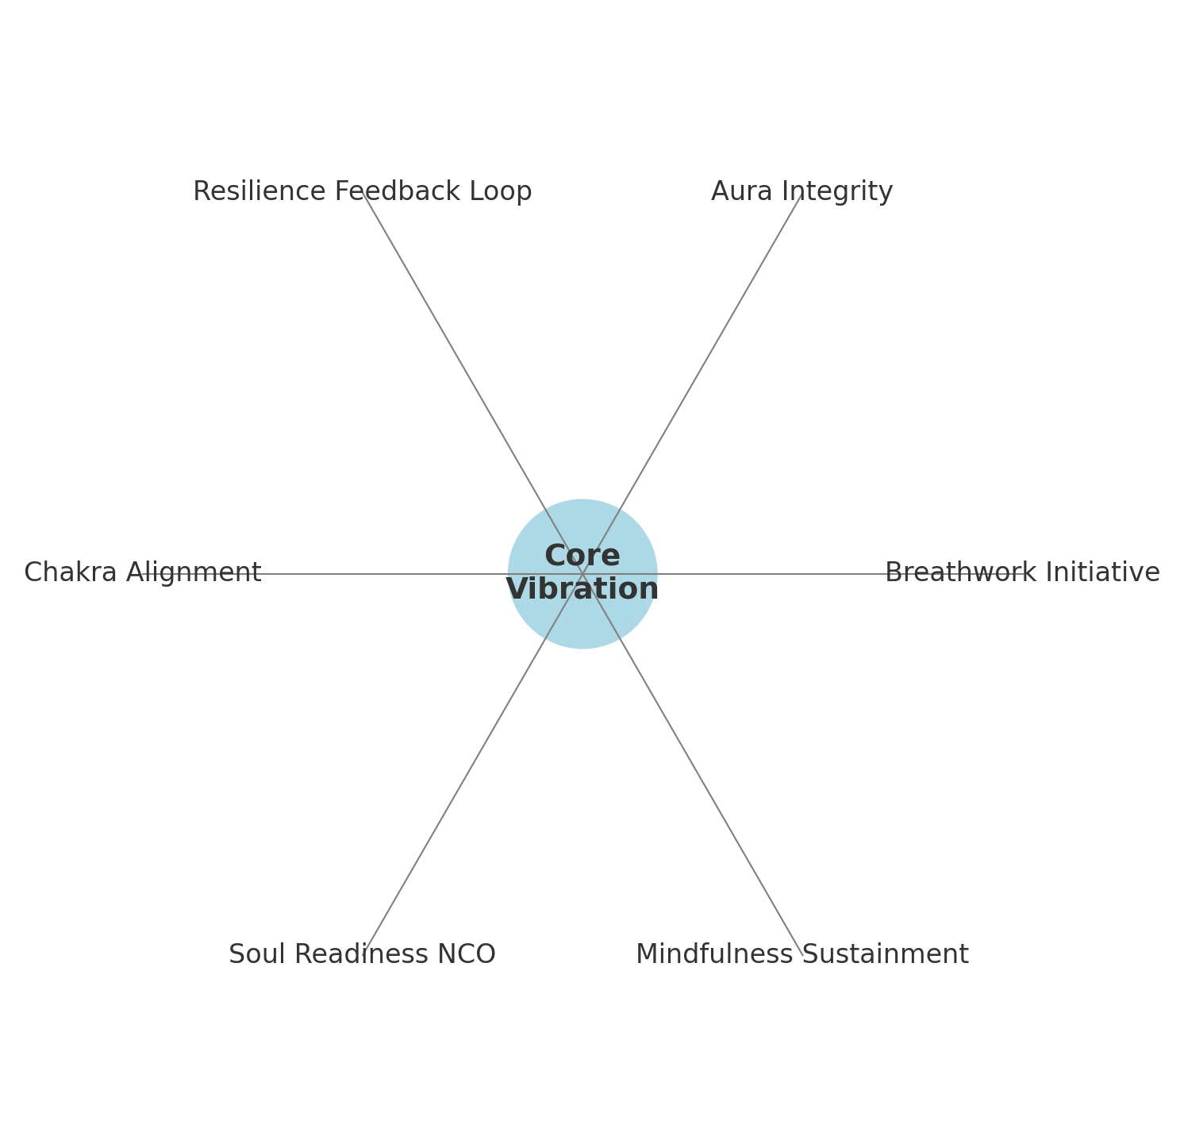
Spiritual Operations Wheel

Slide 3
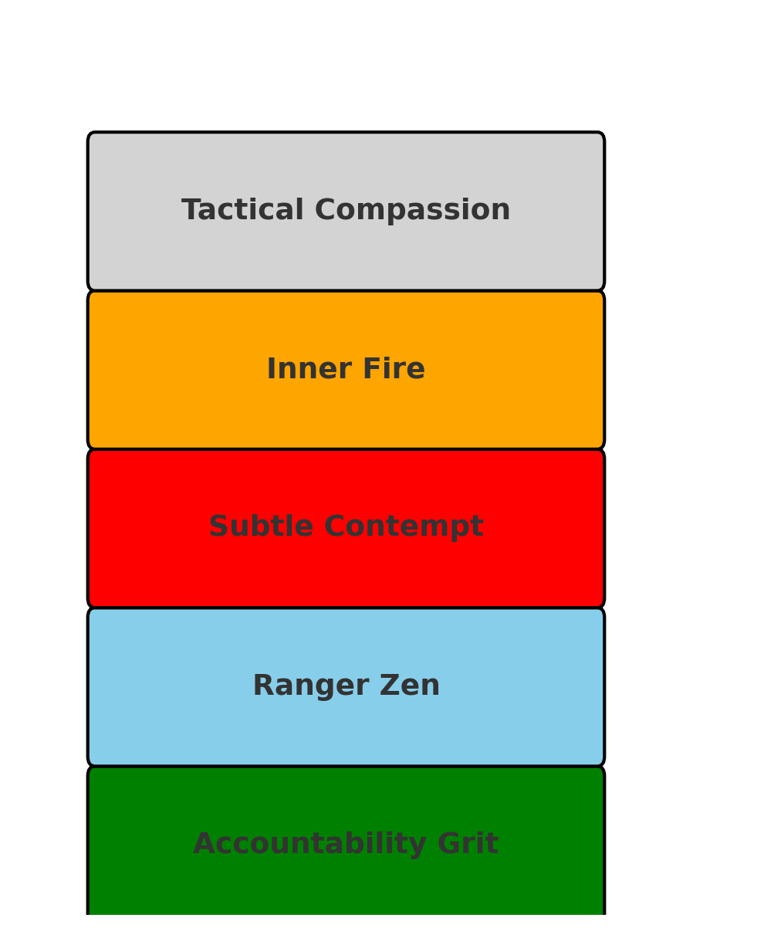
Core Values Rock Chart

Slide 4
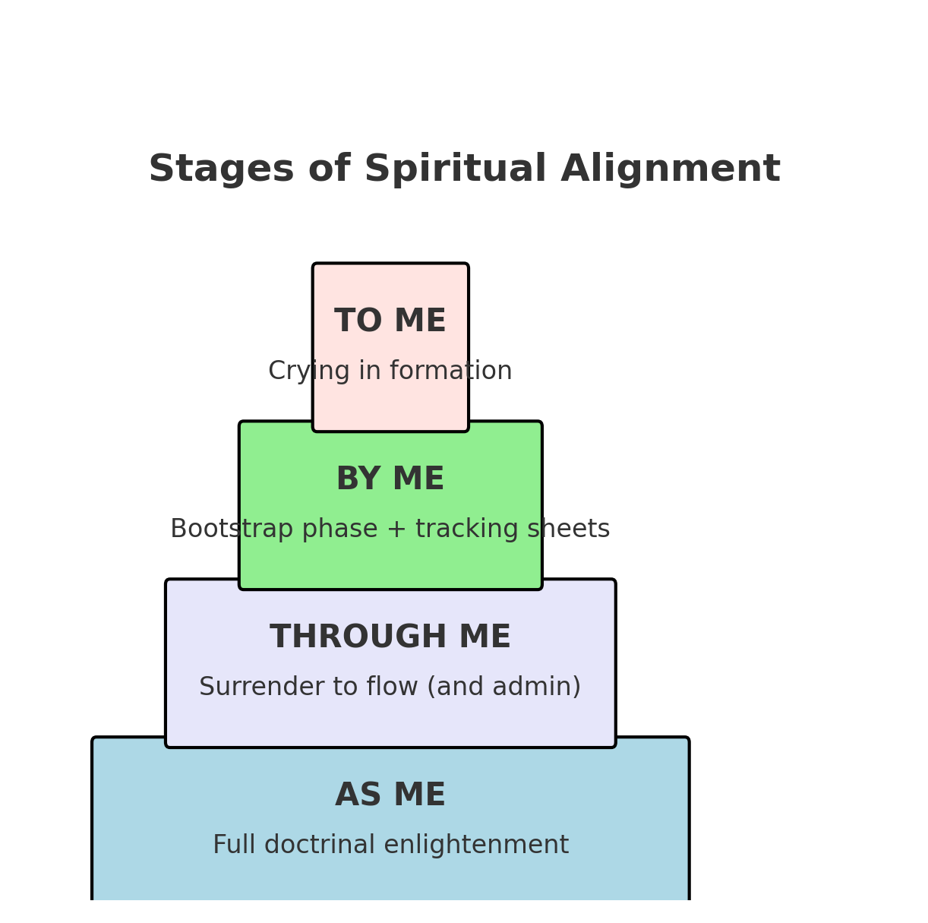

Slide 5
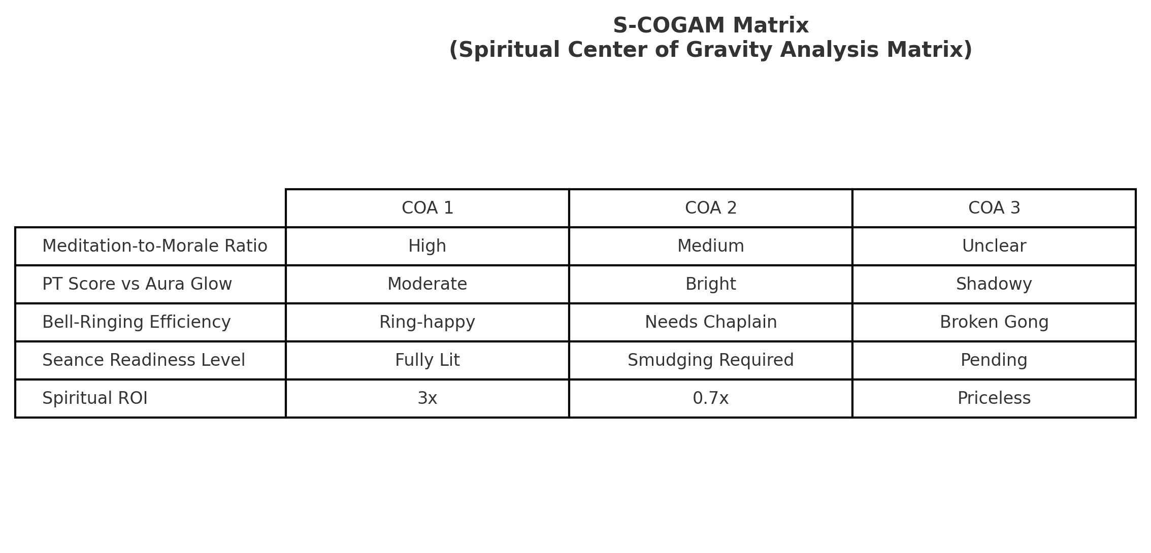
S-COGAM Matrix

Slide 6
Questions?
Please align your aura before raising concerns.

